Slide 1
PreCalculus 12 Ch4 Review

Slide 2
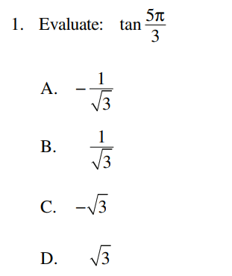
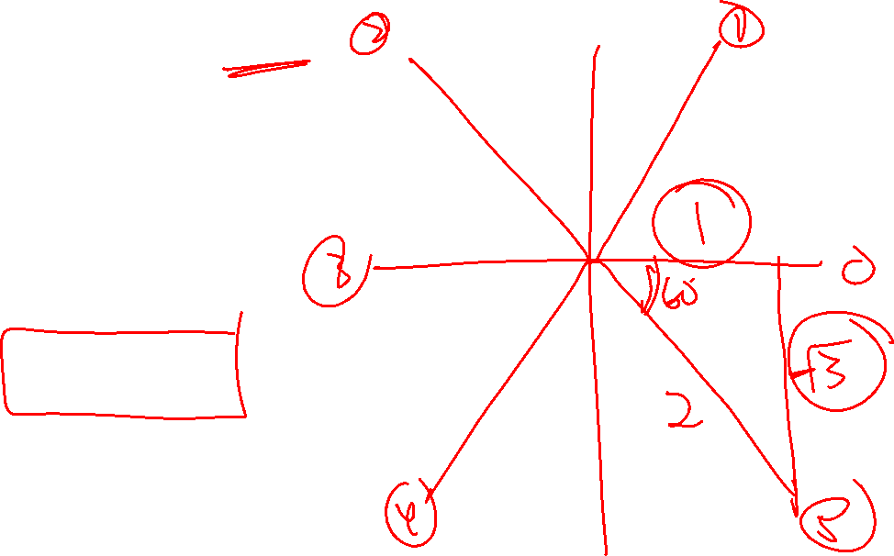

Slide 3
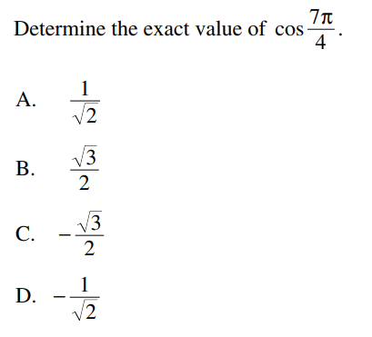
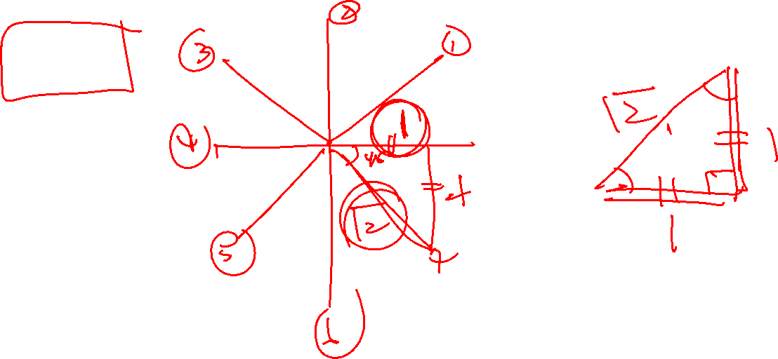

Slide 4
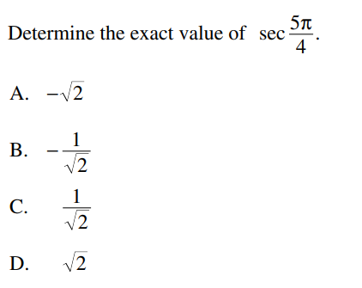
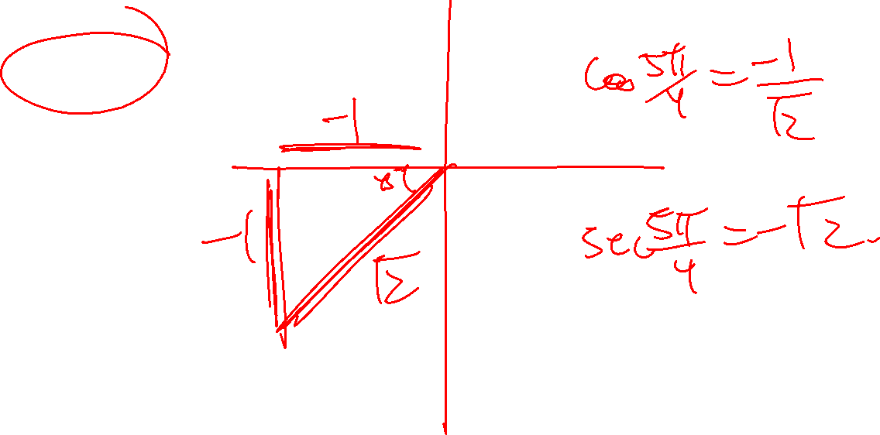

Slide 5
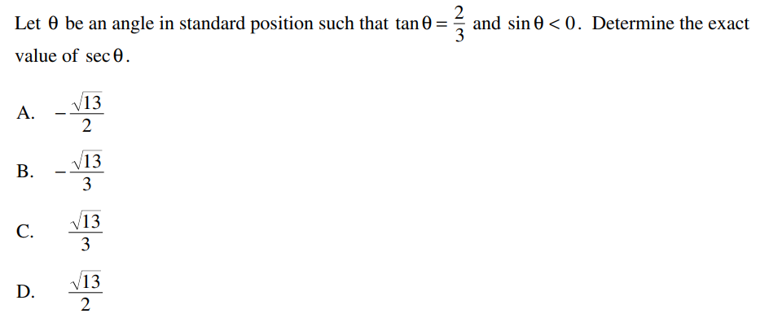
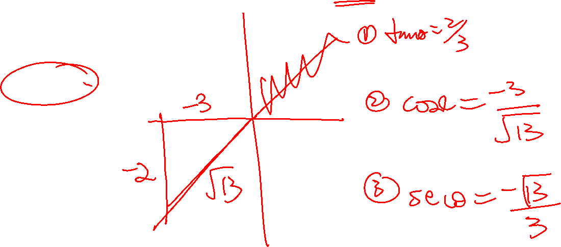

Slide 6
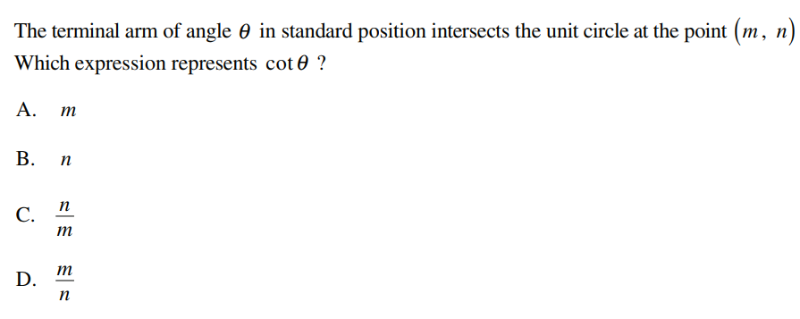
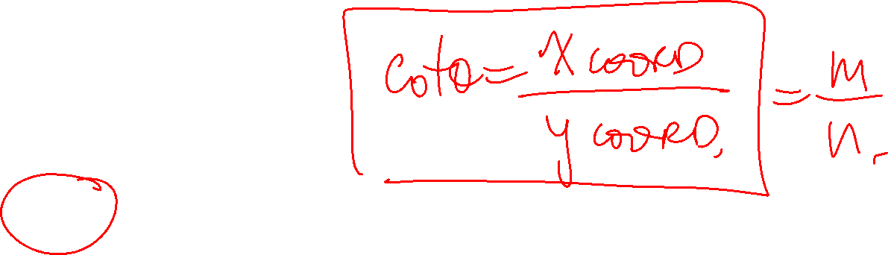

Slide 7
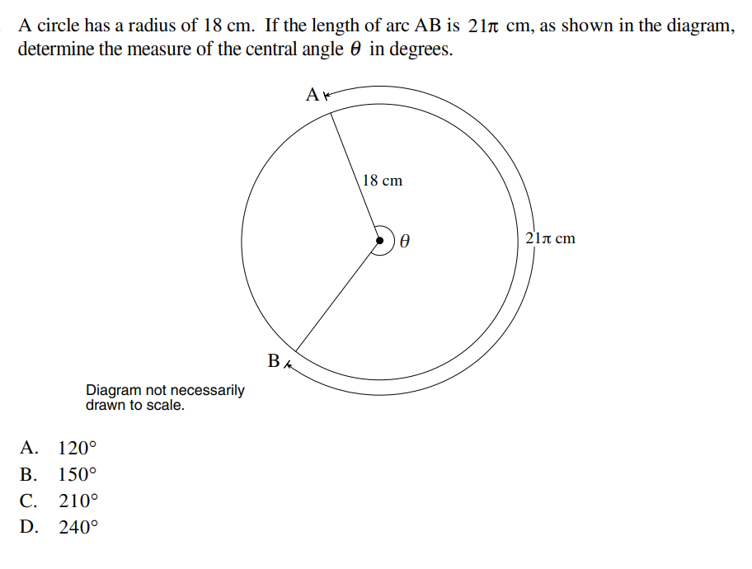
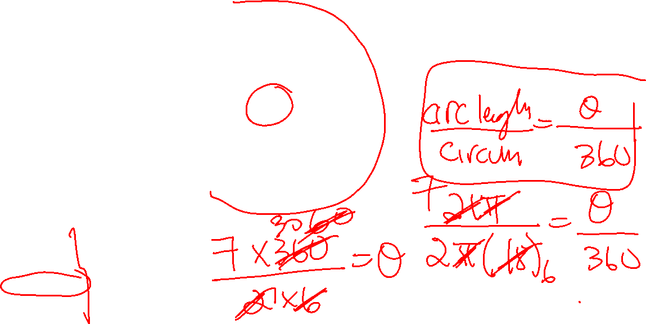

Slide 8
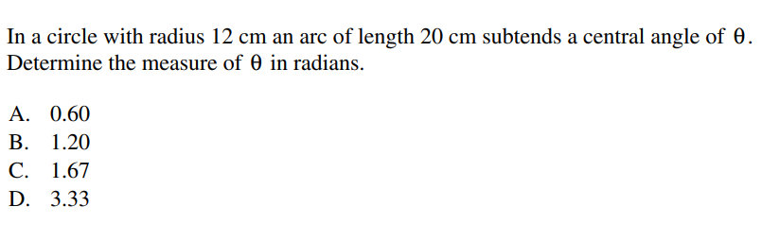
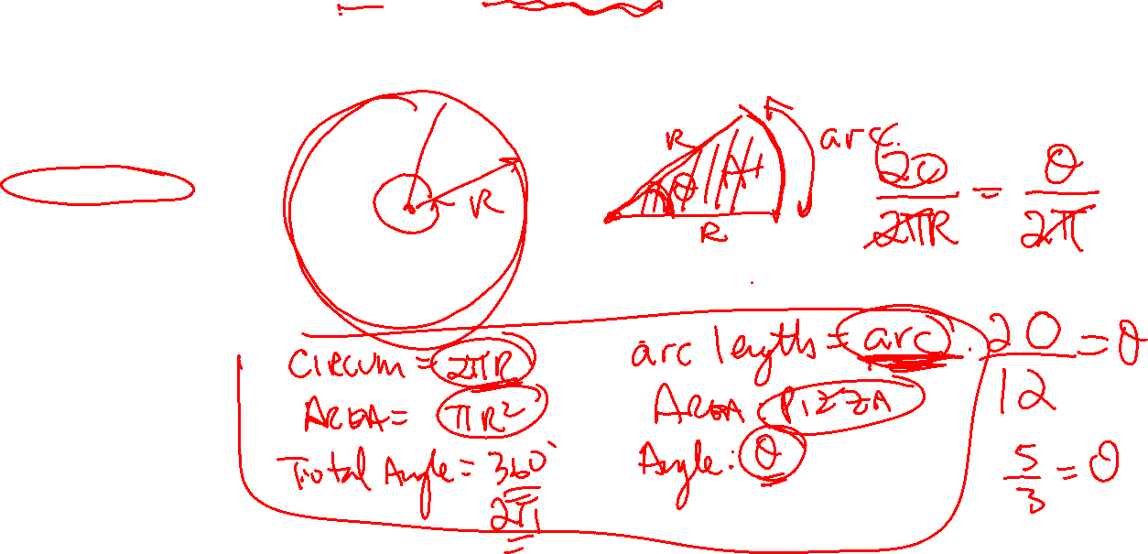

Slide 9
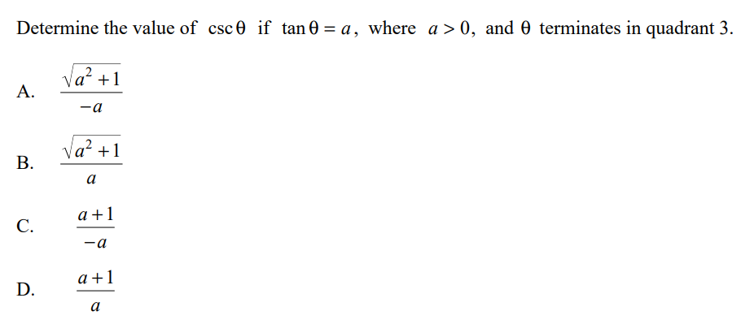
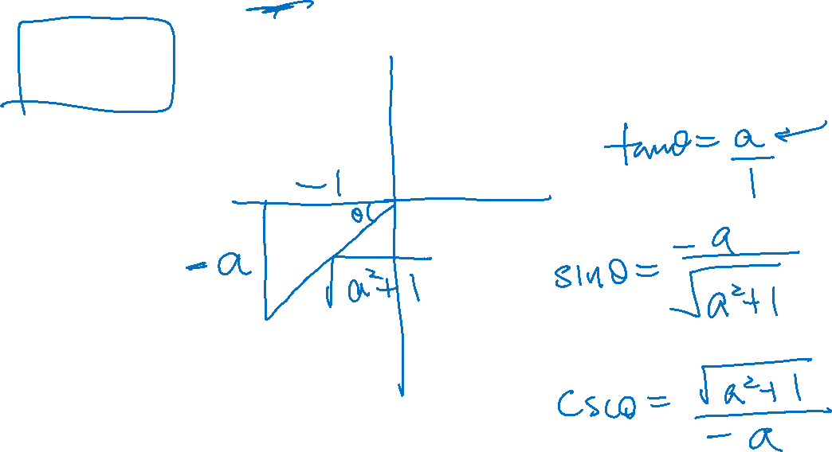

Slide 10
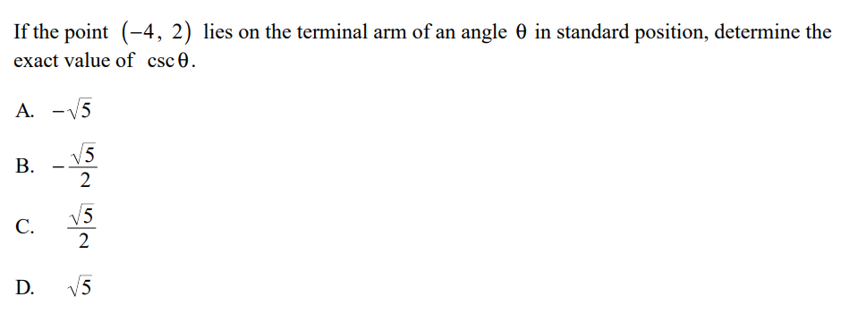
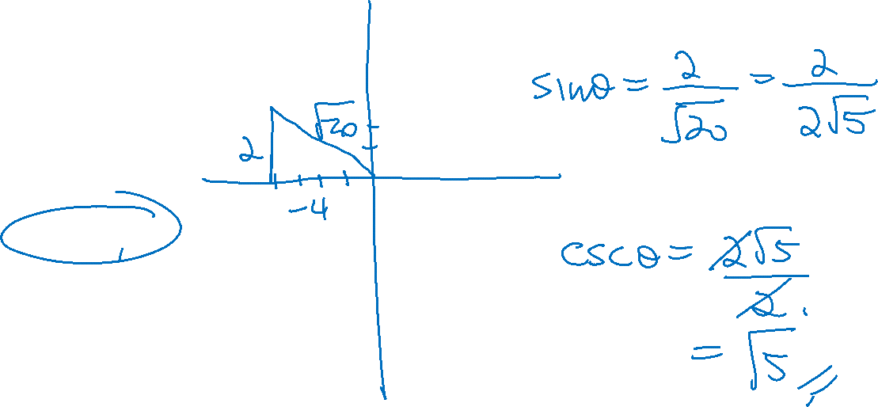

Slide 11
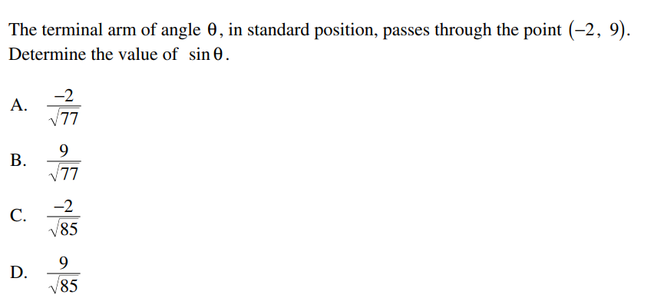
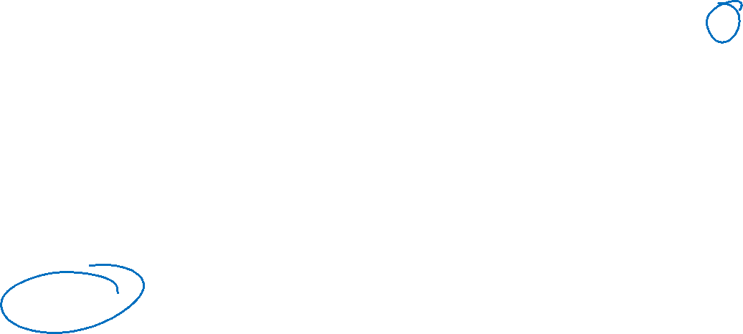

Slide 12
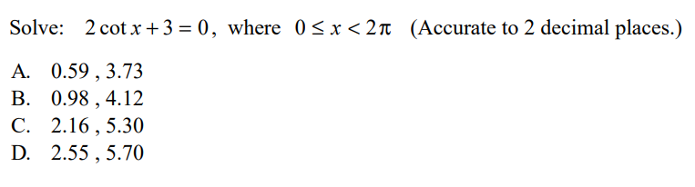
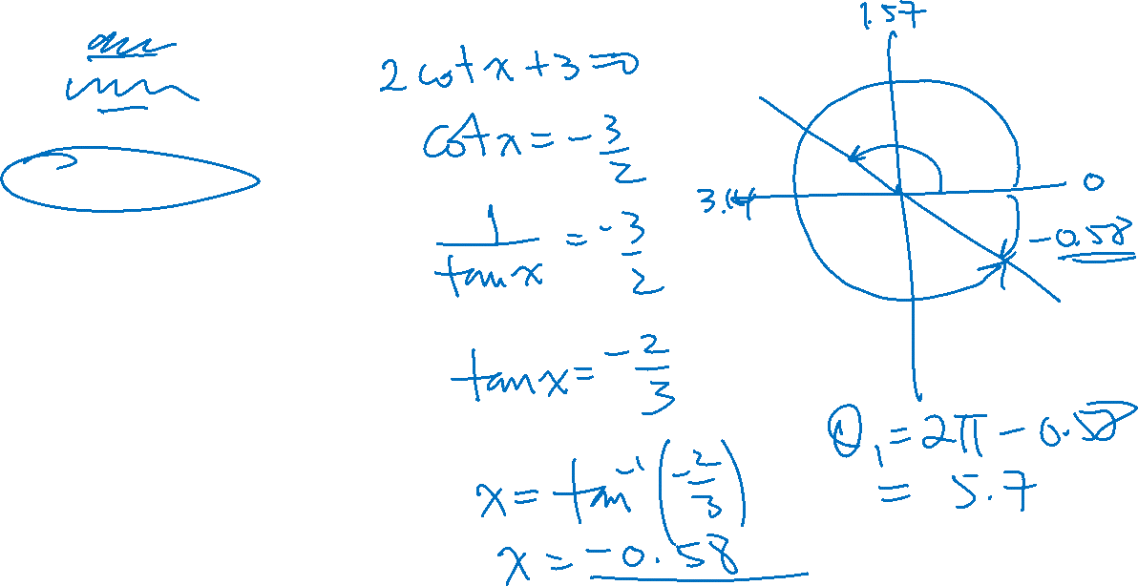

Slide 13
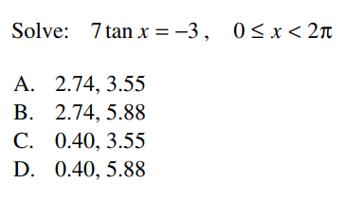
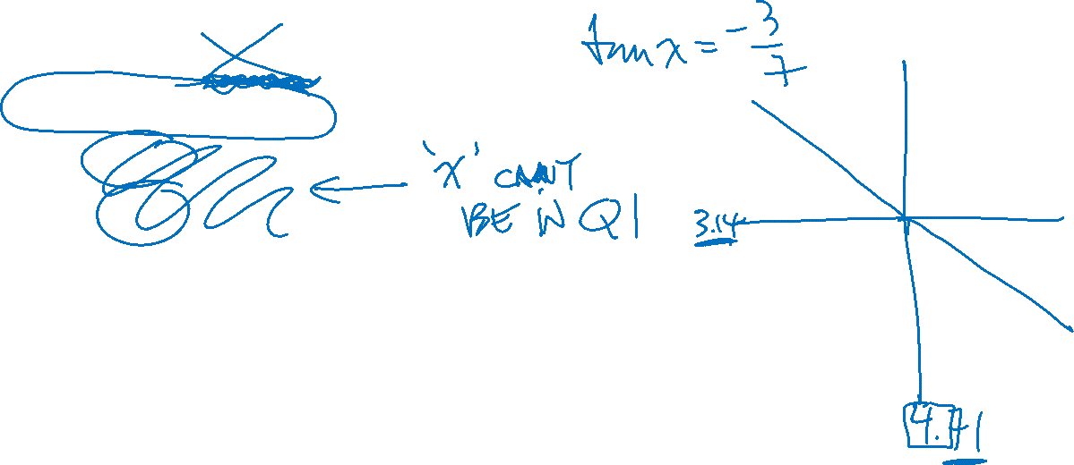

Slide 14
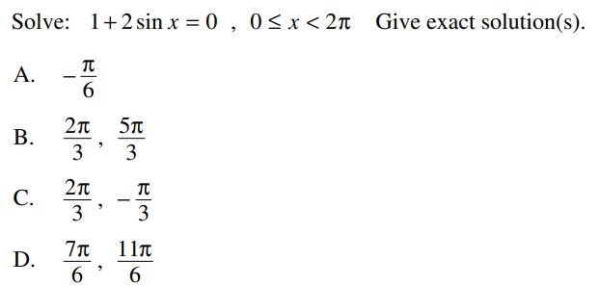
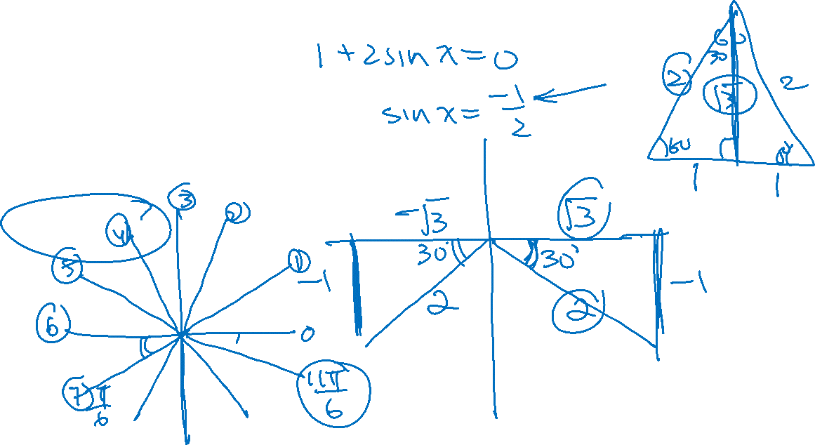

Slide 15
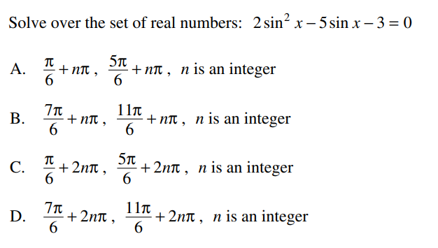
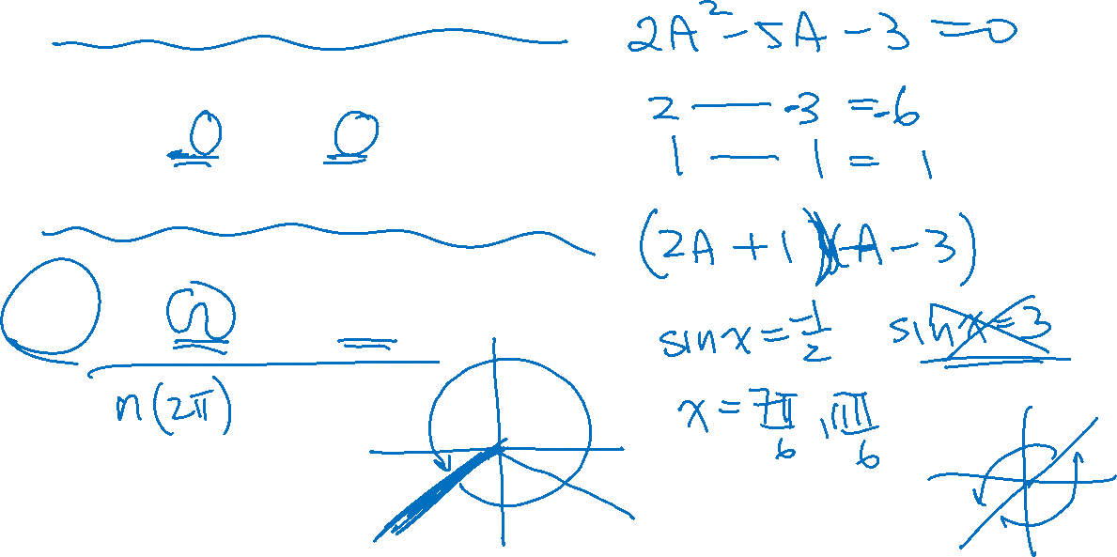

Slide 16
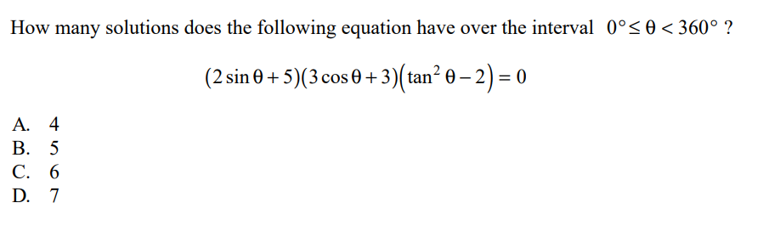
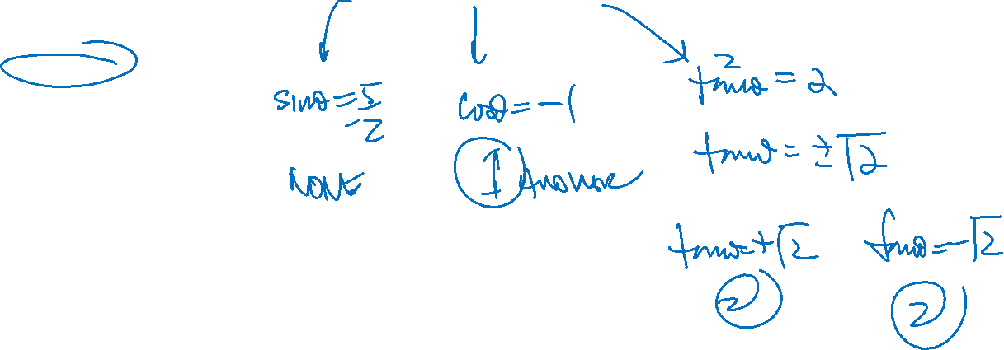

Slide 17
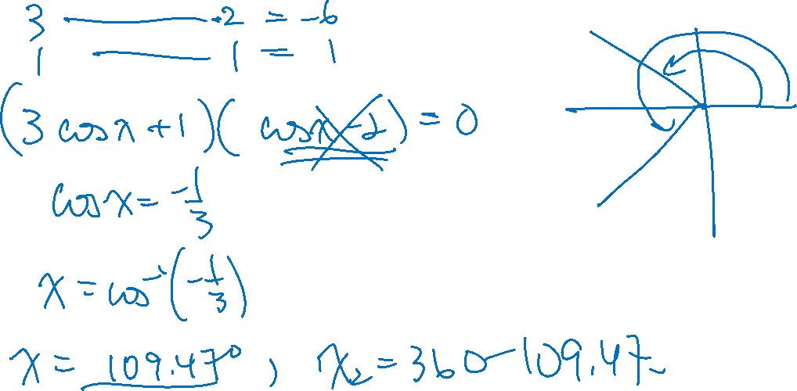

Slide 18
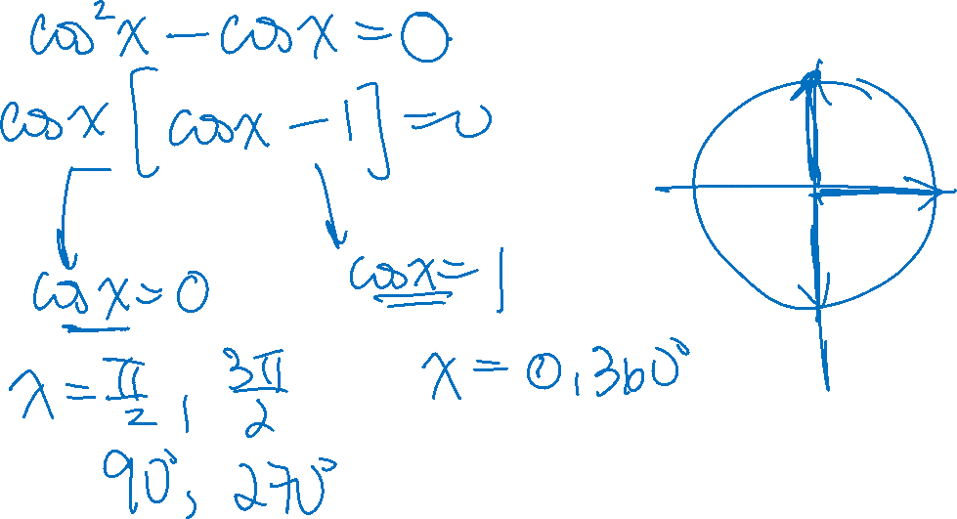

Slide 19

If the value, to the nearest thousandth, of cos Ø is -0.385, which of the following could be true about Ø?
$0≤∅<\frac{π}{6}$
$\frac{π}{6}≤∅<\frac{π}{3}$
$\frac{π}{3}≤∅<\frac{π}{2}$
$\frac{π}{2}≤∅<\frac{2π}{3}$
$\frac{2π}{3}≤∅≤≤π$

Slide 20

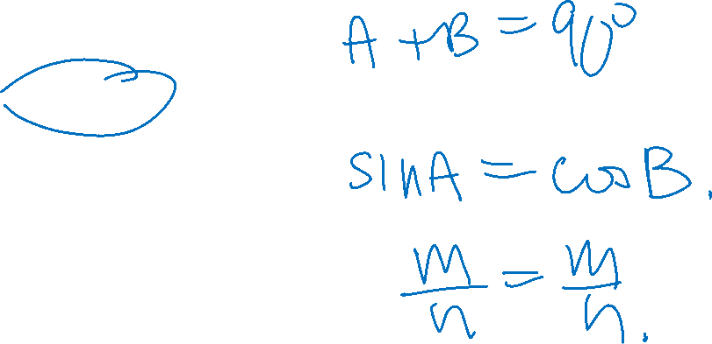
Suppose angles A + B = $\frac{π}{2}$ and you are given that $sinA=\frac{m}{n}$, then which of the following is equal to $cosB?$
$\frac{n}{m}$
$\frac{\sqrt{m^{2}+n^{2}}}{m}$
$\frac{m}{n}$
$±\frac{\sqrt{n^{2}−m^{2}}}{n}$
$−\frac{\sqrt{n^{2}−m^{2}}}{n}$

Slide 21

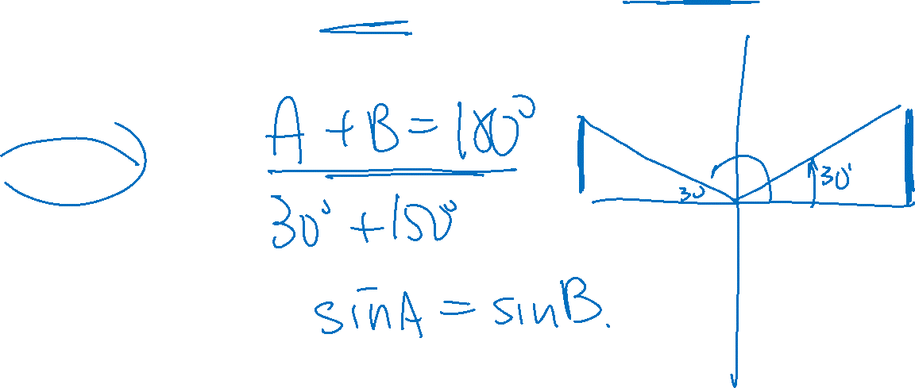
Suppose angles A + B =$π$ and you are given that $sinA=\frac{m}{n}$, then which of the following is equal to $sinB?$
$\frac{n}{m}$
$\frac{\sqrt{m^{2}+n^{2}}}{m}$
$\frac{m}{n}$
$±\frac{\sqrt{n^{2}−m^{2}}}{n}$
$−\frac{\sqrt{n^{2}−m^{2}}}{n}$

Slide 22
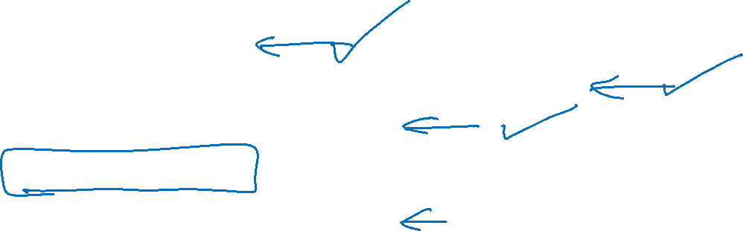
Suppose we are given that sinA = sinB, which of the following could be a reason why they are equal?
Angles A + B = π
Angles “A” and “B” are coterminal, A = B ± 2πn
Angles “A” and “B” are equal
All of the above
Only “B” and “C” are correct

Slide 23

INDICATE whether if the following statements are true or False?
The range of cscØ is y>1 or y<1
There are no solutions to the equation secØ = 0.85
The range of secØ is all real numbers?
The range of cotØ is all real numbers?
The domain of cotØ is all real numbers?
The domain of cscØ is all real numbers?

Slide 24
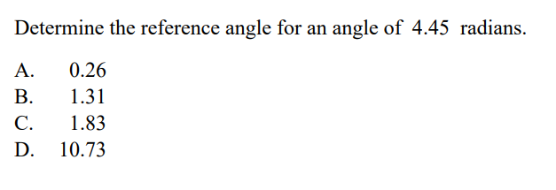
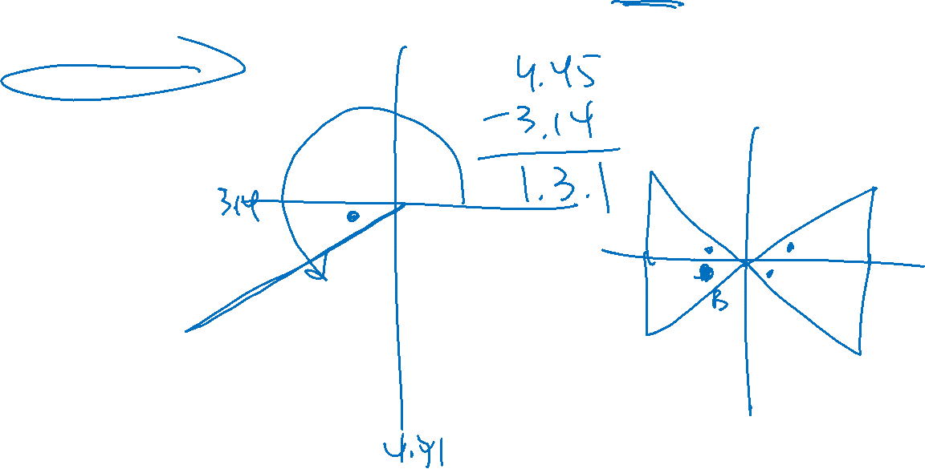

Slide 25
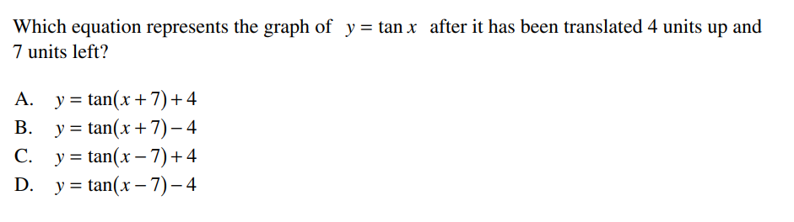

Slide 26
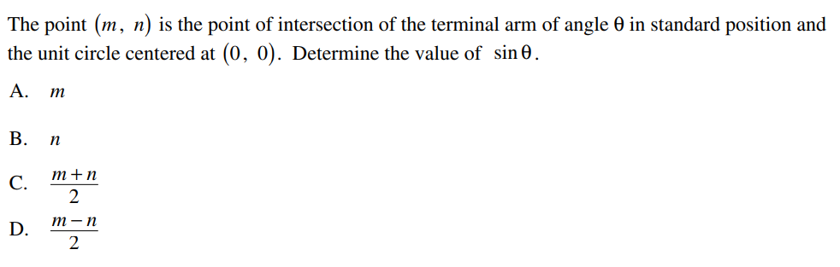
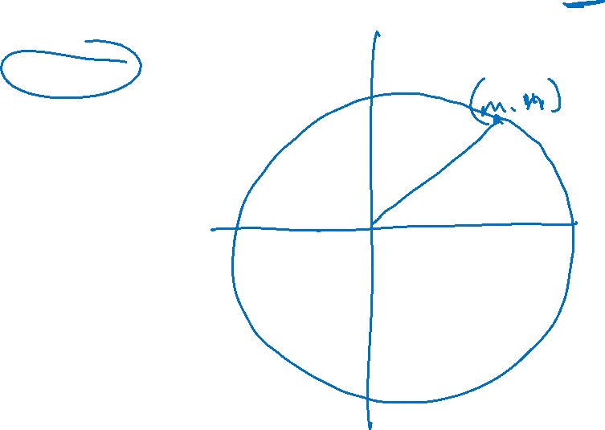

Slide 27
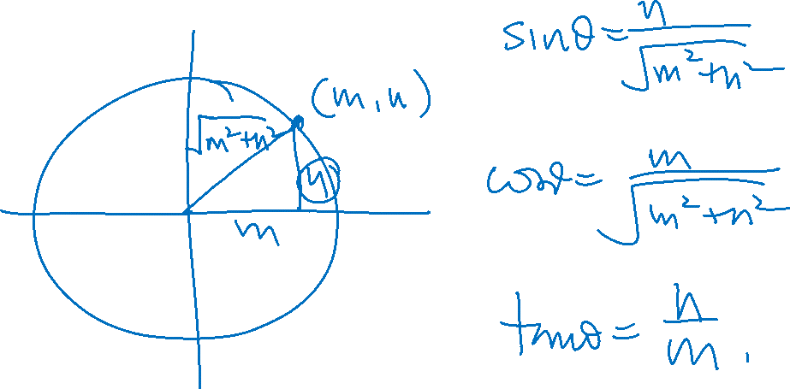
Suppose the point (m,n) is the point of intersection of the terminal of angle Ø in standard position and a circle centered at (0,0). Suppose this circle is NOT an unit circle. Determine the values of
i) sin Ø ii) cos Ø iii) tan Ø

Slide 28
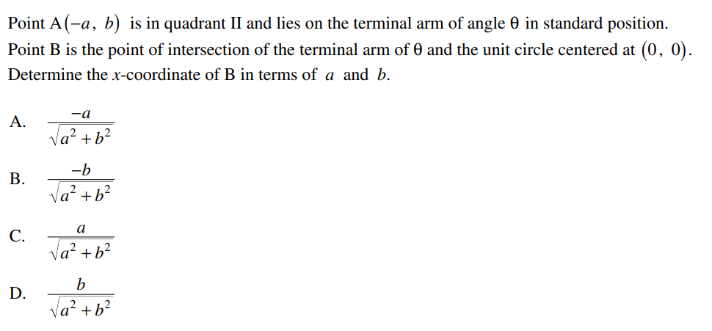

Slide 29
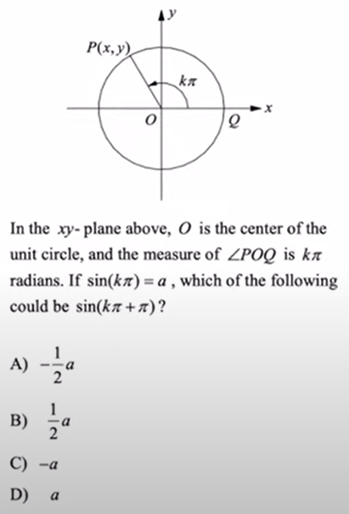

Slide 30
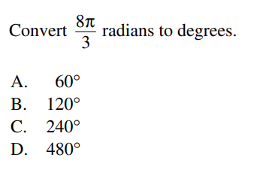

Slide 31
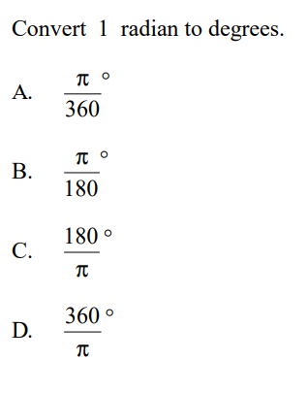

Slide 32
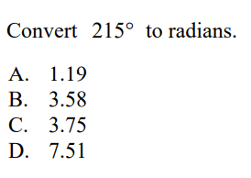

Slide 33
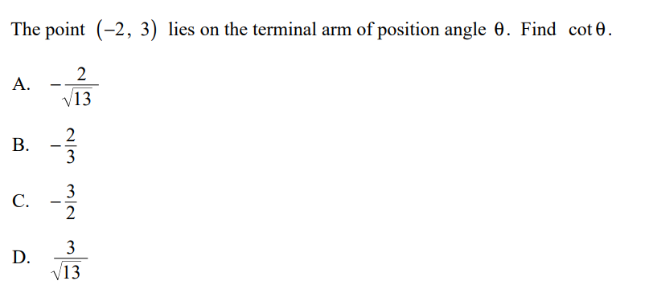

Slide 34



Slide 35


Slide 36


Slide 37


Slide 38


